Slide 1
Neural Networks
Building Blocks for DL

Slide 2
Contents
An example NN
Tensors and tensor operations
How NN learn

Slide 3
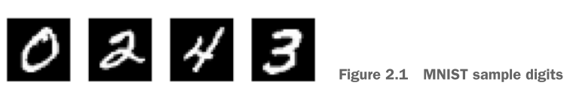
Example: Classify Handwritten Digits
Keras library
MNIST dataset
Classify grayscale images of handwritten digits (28 pixels x 28 pixels) into 10 categories (0 to 9)
60,000 training samples, 10,000 test samples
In ML, a category is called a class. Data points are samples. Class associated with a specific sample is called label.

Slide 4
Code
https://github.com/jjallaire/deep-learning-with-r-notebooks.git
Open 2.1: A first look

Slide 5
MNIST Example
Load training and test data
Build network
Compile
Loss function
Optimizer
Metrics to monitor during training and testing
Preprocess data before training
Array_reshape, rather than dim
Categorically encode labels
Train
Test

Slide 6
Data Representation - Tensors
Tensors are a generalization of vectors and matrices to an arbitrary number of dimensions (note that in the context of tensors, a dimension is often called an axis).
In R, vectors are used to create and manipulate 1D tensors, and matrices are used for 2D tensors. For higher-level dimensions, array objects (which support any number of dimensions) are used.

Slide 7
Scalars (0D tensors)
A tensor that contains only one number is called a scalar (or scalar tensor, or zero-dimensional tensor, or 0D tensor)

Slide 8
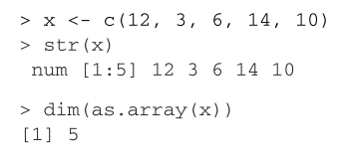
Vectors (1D tensor)
A one-dimensional array of numbers is called a vector, or 1D tensor. A 1D tensor is said to have exactly one axis.
This is a 5-dimensional vector, not a 5D tensor. Dimensionality can refer to the number of entries along a specific axis, or the number of axes in a tensor (5D tensor). In the latter case, we say it is a tensor of rank 5.

Slide 9
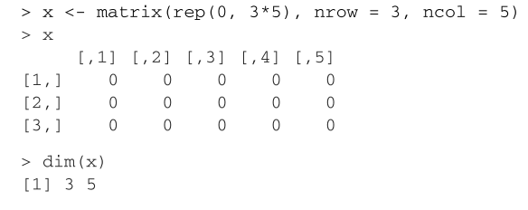
Matrices (2D tensor)
A two-dimensional array of numbers is a matrix, or 2D tensor. A matrix has two axes (often referred to as rows and columns)

Slide 10
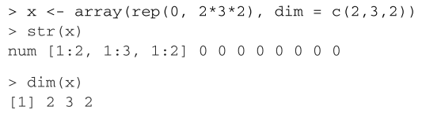
3D tensors and Higher
If you pack such matrices in a new array, you obtain a 3D tensor, which you can visually interpret as a cube of numbers:

Slide 11
Key Attributes
Number of axes (rank)
Shape - This is an integer vector that describes how many dimensions the tensor has along each axis. For instance, the previous matrix example has shape (3, 5).
Data Type - This is the type of the data contained in the tensor; for instance, a tensor’s type could be integer or double. On rare occasions, you may see a character tensor. But because tensors live in preallocated contiguous memory segments, and strings, being variable-length, would preclude the use of this implementation, they’re rarely used.

Slide 12
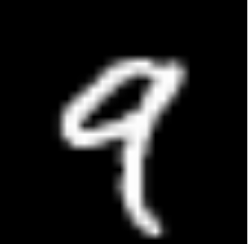
Example MNIST - cont.
length(dim(train_images))
[1] 3
dim(train_images)
[1] 60000 28 28
typeof(train_images)
[1] "integer"
Plot the 5th sample
digit <- train_images[5,,]
plot(as.raster(digit, max = 255))

Slide 13
Manipulating Tensors
Selecting specific elements in a tensor is called tensor slicing.
> my_slice <- train_images[10:99,,]
> dim(my_slice)
[1] 90 28 28

Slide 14
Data Batches
The first axis in all data tensors is usually the sample axis
Most models don’t process all the data at once, but in batches. In such cases, the first axis is called batch axis or batch dimension.
Vector data—2D tensors of shape (samples, features)
Timeseries data or sequence data—3D tensors of shape (samples, timesteps, features)
Images—4D tensors of shape (samples, height, width, channels) or (samples, channels, height, width)
Video—5D tensors of shape (samples, frames, height, width, channels) or (samples, frames, channels, height, width)

Slide 15
Vector Data - Example
An actuarial dataset of people, where we consider each person’s age, ZIP code, and income. Each person can be characterized as a vector of 3 values, and thus an entire dataset of 100,000 people can be stored in a 2D tensor of shape (100000, 3).
A dataset of text documents, where we represent each document by the counts of how many times each word appears in it (out of a dictionary of 20,000 common words). Each document can be encoded as a vector of 20,000 values (one count per word in the dictionary), and thus an entire dataset of 500 documents can be stored in a tensor of shape (500, 20000).

Slide 16
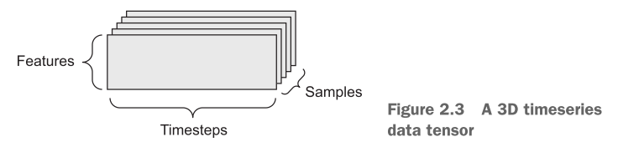
Timeseries Data
By convention, time is always the second axis
A dataset of stock prices. Every minute, we store the current price of the stock, the highest price in the past minute, and the lowest price in the past minute. Thus, every minute is encoded as a 3D vector, an entire day of trading is encoded as a 2D tensor of shape (390, 3) (there are 390 minutes in a trading day), and 250 days’ worth of data can be stored in a 3D tensor of shape (250, 390, 3). Here, each sample would be one day’s worth of data.

Slide 17
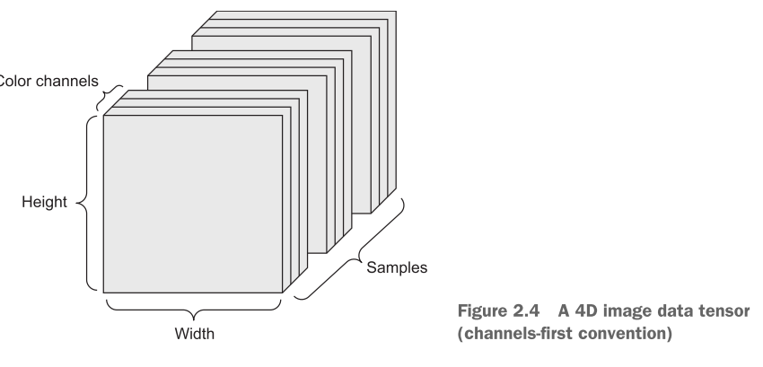
Image Data
A batch of 128 color images could be stored in a tensor of shape (128, 256, 256, 3)
The TensorFlow framework, places the color-depth axis at the end
For instance, a 60-second, 144 × 256 YouTube video clip sampled at 4 frames per
second would have 240 frames. A batch of four such video clips would be stored in a tensor of shape (4, 240, 144, 256, 3). That’s a total of 106,168,320 values! If the data type of the tensor is double, then each value is stored in 64 bits, so the tensor would represent 810 MB!

Slide 18
Tensor Operations
The above takes as input a 2D tensor, and returns another 2D tensor
Specifically, a function as follows, where w is a 2D tensor, and b is a vector
relu operation and addition are element-wise operations; operations that are applied independently to each entry in the tensors being considered
These are amenable to massively parallel implementations
Install the BLAS (Basic Linear Algebra Subprograms), which are low-level highly parallel, efficient tensor manipulation routines
z<-x+y ←- Element-wise addition
z <- pmax(z, 0) ←- Element-wise relu
layer_dense(units = 512, activation = "relu")
output = relu(dot(W, input) + b)
Notes:
relu(x) = max(x,0)

Slide 19
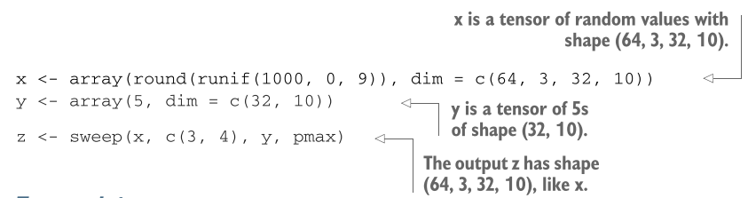
Operations involving Different Dimensions
The R sweep() function enables you to perform operations between higher dimension tensors and lower-dimension tensors

Slide 20
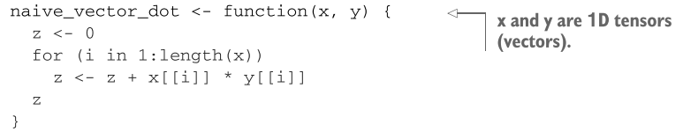
Tensor dot (product)
An element-wise product is done with the * operator in R, whereas dot products use the %*% operator:
z <-x %*% y
In mathematical notation, you’d note the operation with a dot (.)

Slide 21
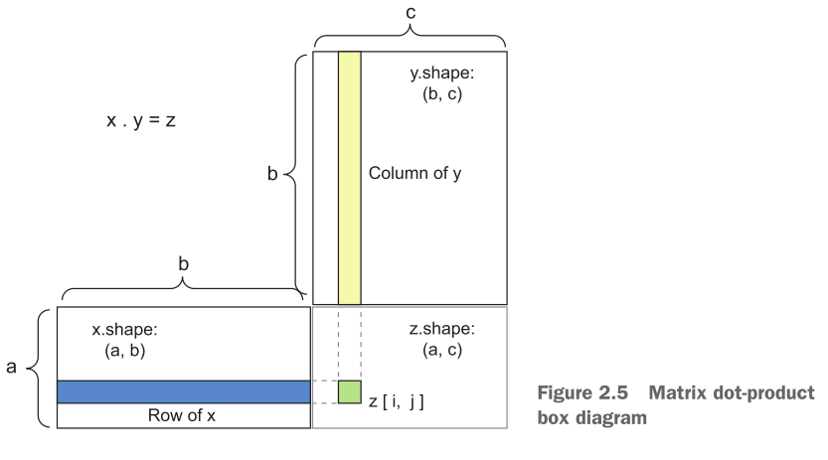
Matrix dot product

Slide 22
Tensor Reshaping
Note that we use the array_reshape() function rather than the dim<-() function to reshape the array. This is so that the data is reinterpreted using row-major semantics (as opposed to R’s default column-major semantics)
Always use array_reshape()
train_images <- array_reshape(train_images, c(60000, 28 * 28))

Slide 23
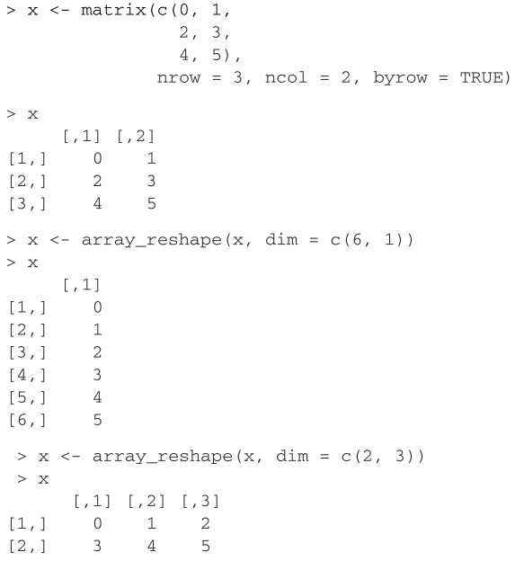
Reshaping - Example

Slide 24
A Geometric Interpretation of DL
Neural networks consist entirely of chains of tensor operations and that all of these tensor operations are just geometric transformations of the input data. It follows that you can interpret a neural network as a very complex geometric transformation in a high-dimensional space, implemented via a long series of simple steps

Slide 25
Gradient-Based Optimization
In a neural layer, we transform input to output as follows:
W and b are tensors that are attributes. These are called the weights of the layer. Initially, random values are assigned. The idea is to tune the weights based on a feedback signal so that our output matches the expected target. This adjustment is called training.
output = relu(dot(W, input) + b)

Slide 26
Training Loop
Draw a batch of training samples x and corresponding targets y.
Run the network on x (a step called the forward pass) to obtain predictions y_pred.
Compute the loss of the network on the batch, a measure of the mismatch between y_pred and y.
Update all weights of the network in a way that slightly reduces the loss on this batch.
Given an individual weight coefficient in the network, how can you compute whether the coefficient should be increased or decreased, and by how much?
Notes:
A much better approach is to take advantage of the fact that all operations used in the network are differentiable, and compute the gradient of the loss with regard to the network’s coefficients. You can then move the coefficients in the opposite direction from the gradient, thus decreasing the loss.

Slide 27
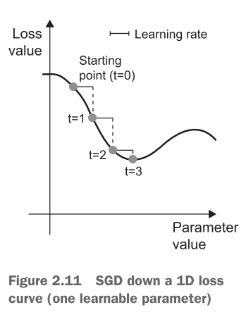
Stochastic Gradient Descent
Draw a batch of training samples x and corresponding targets y.
Run the network on x to obtain predictions y_pred.
Compute the loss of the network on the batch, a measure of the mismatch between y_pred and y.
Compute the gradient of the loss with regard to the network’s parameters (a backward pass).
Move the parameters a little in the opposite direction from the gradient—for example, W=W - (step * gradient)—thus reducing the loss on the batch a bit
This is a mini-batch SGD

Slide 28
The Backpropagation Algorithm
Uses the “chain rule,” which indicates that a chain of functions can be differentiated using the following identity, called the chain rule: f(g(x)) = f'(g(x)) * g'(x). Applying the chain rule to the computation of the gradient values of a neural network gives rise to an algorithm called Backpropagation (also sometimes called reverse-mode differentiation).
Backpropagation starts with the final loss value and works backward from the top layers to the bottom layers, applying the chain rule to compute the contribution that each parameter had in the loss value.

Slide 29
Our Example

Slide 30
Summary
Learning means finding a combination of model parameters that minimizes a loss function for a given set of training data samples and their corresponding targets.
Learning happens by drawing random batches of data samples and their targets, and computing the gradient of the network parameters with respect to the loss on the batch.
The entire learning process is made possible by the fact that neural networks are chains of differentiable tensor operations, and thus it’s possible to apply the chain rule of derivation to find the gradient function mapping the current parameters and current batch of data to a gradient value.

Slide 31
Summary (cont.)
Two key concepts you’ll see frequently in future chapters are loss and optimizers. These are the two things you need to define before you begin feeding data into a network:
The loss is the quantity you’ll attempt to minimize during training, so it should represent a measure of success for the task you’re trying to solve.
The optimizer specifies the exact way in which the gradient of the loss will be used to update parameters: for instance, it could be the RMSProp optimizer, SGD with momentum, and so on.

Slide 32
Installing Keras
install.packages("keras") - Installs the Keras R package
library(keras)
install_keras() - Installs the core Keras library and TensorFlow
You might have to install Anaconda. I had luck with the 2.7 version in Windows, rather than the 3.x version.

